Slide 1
RJDS
Uniforms
2025-2026

Slide 2
A Message From The RJDS Uniform Committee
In early 2022, several RJDS parents formed a committee to plan the new design and execution of RJDS’ new uniforms. We researched and negotiated for months to ensure we chose items that were high-quality, comfortable, relatively affordable, and inclusive.
All K-7 students are required to wear the school uniform. We appreciate the cooperation of all RJDS families in adhering to the following guidelines, so each student is prepared as a proud representative of our amazing little school.

Slide 3
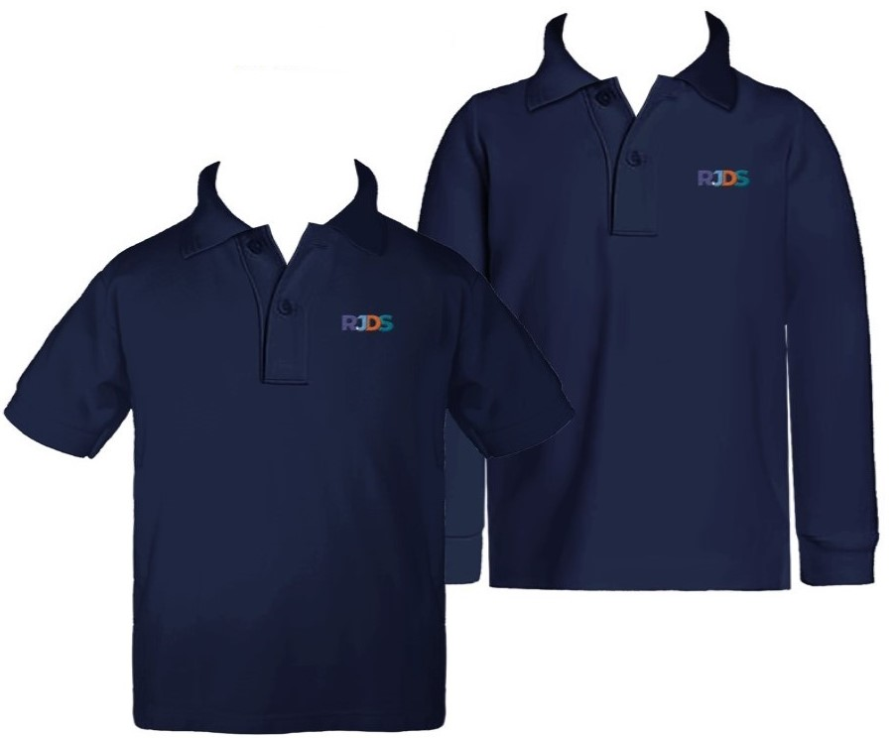
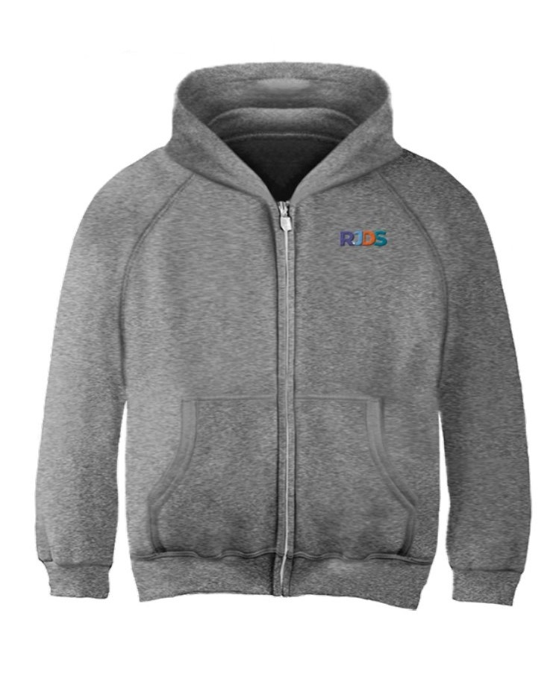
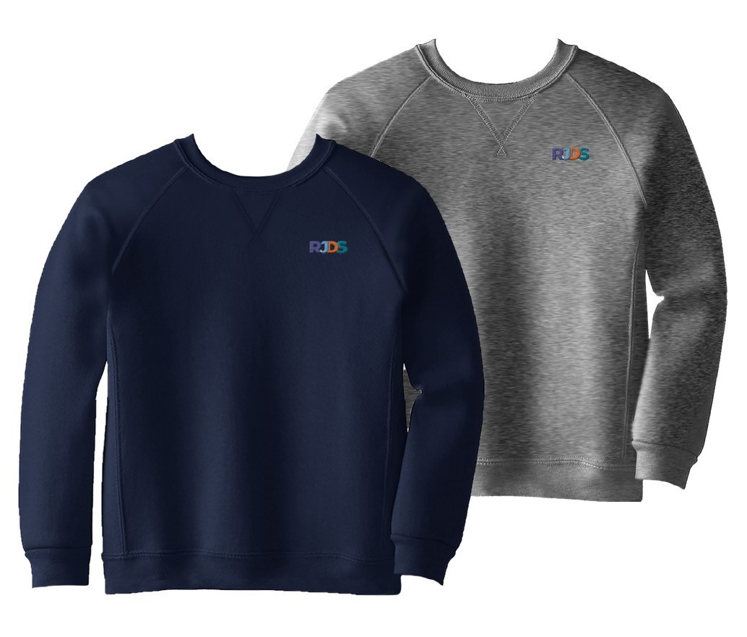
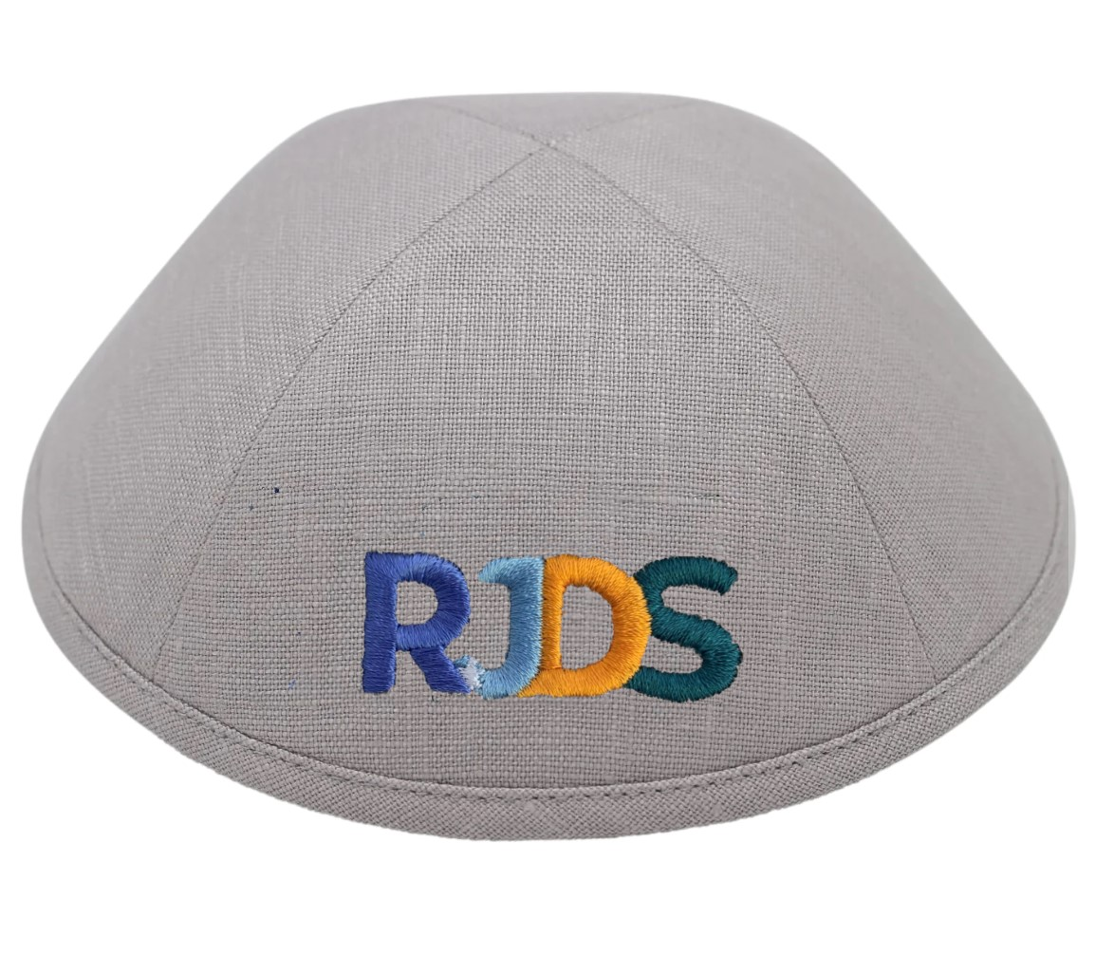
Daily uniform Top options
Optional Add-ons
Zip-up Hooded Sweatshirt
  RJDS-Branded or Unbranded
  Colour: Heather Grey
Mandatory
RJDS-Branded Golf Shirt
  Short- or Long-sleeved
  COLOUR: NAVY
  OR
RJDS-Branded Crewneck Sweatshirt
  Long-sleeved
  COLOUR: NAVY or HEATHER GREY
Kippah for boys (optional for girls)
  Any
RJDS-Branded Kippah
  Every boy should have at least one for special occasions

Slide 4
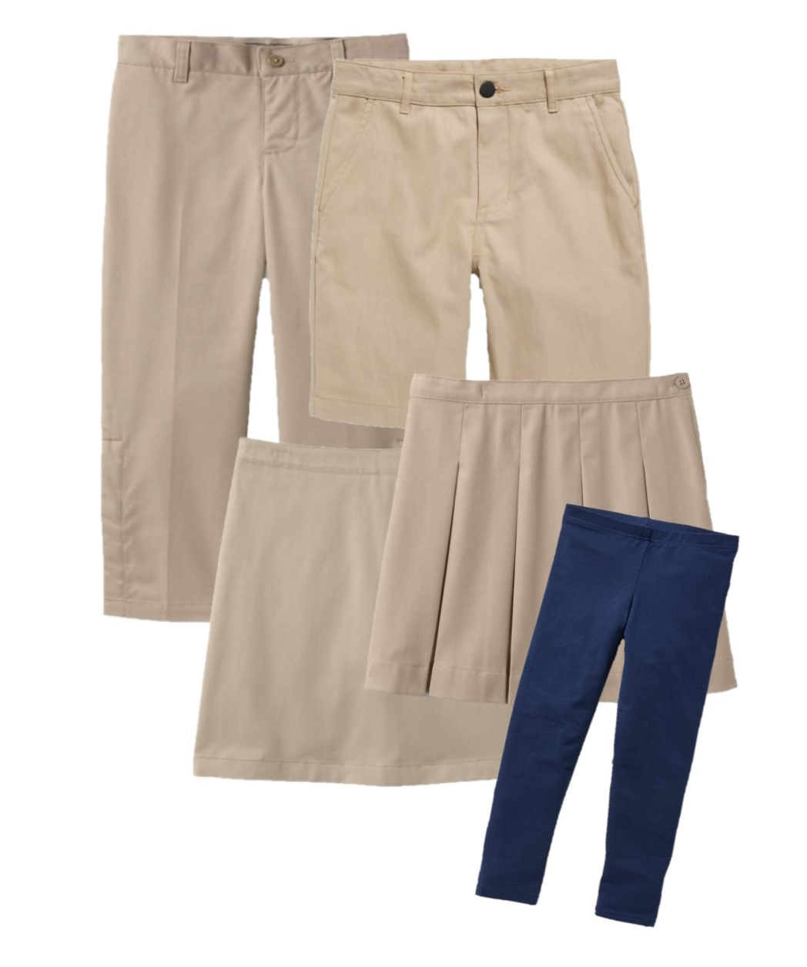
Daily uniform Bottom options
Pants/Shorts
  Chinos, Trousers, Cargo, or similar
  COLOUR: Light/medium KHAKI (NOT tan)
OR
Skort or Skirt(with shorts underneath)
  COLOUR: Light/medium KHAKI (NOT tan)
  WITH: Tights, Legging OR Kneesocks (optional)
    COLOUR: NAVY
WITH
Well-fitting, Closed-toe Shoes

Slide 5
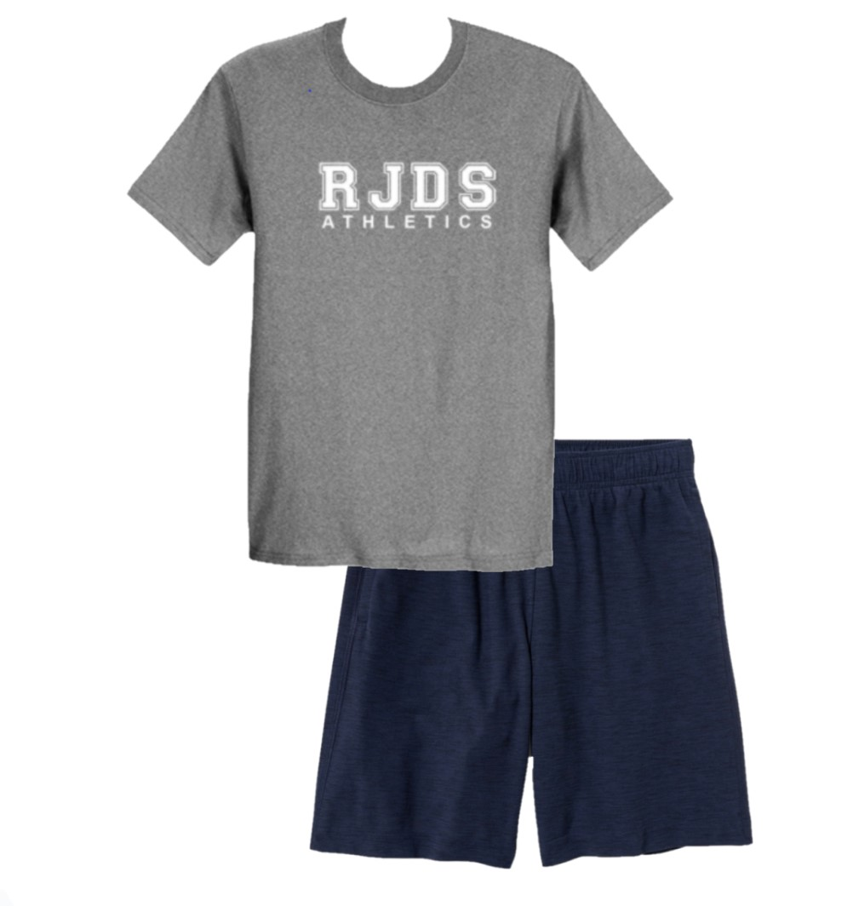
GYM STRIP
For students in grades 4-7 during PE class.
RJDS Athletics Branded Tee
  To be purchased directly from school for $25 at any time for
  COLOUR: HEATHER GREY
AND
Unbranded Athletic Sweatpants or Shorts
  COLOUR: NAVY
AND
Skidproof Running Shoes

Slide 6
Ordering Guide
All branded items must be supplied by Cambridge Uniforms (except kippot, which are from iKippah, and gym strip).
Unbranded items may be purchased anywhere. Please make sure they follow the guidelines.
If you would like to purchase a branded kippah in-between scheduled orders, contact the office.
The Uniform Committee arranges 3-4 bulk ordering periods throughout the school year. Families will be notified and sent an order form to submit to the committee, as well as payment information. There will also be used uniform sales throughout the year, which will be advertised through the PAC page and weekly newsletter (the Shofar)
For questions or to receive the order form link, contact rjdsuniforms@gmail.com

Slide 7
Sizing Guide
With our new ordering system, Cambridge is no longer able to do in-person fittings.
RJDS has all sizes of long-sleeved golf shirt samples to try on for sizing, and a few sizes of the pullover sweatshirt.
For all items without samples, use the size charts on the following pages for measurements. Do NOT use the old uniforms for sizing, as Cambridge has since changed their sizes.
It is highly recommended that you order at least one size larger than what your child fits, if trying on an unwashed sample. Some items are 100% cotton and will shrink by 1 to 2 inches after washing.

Slide 8
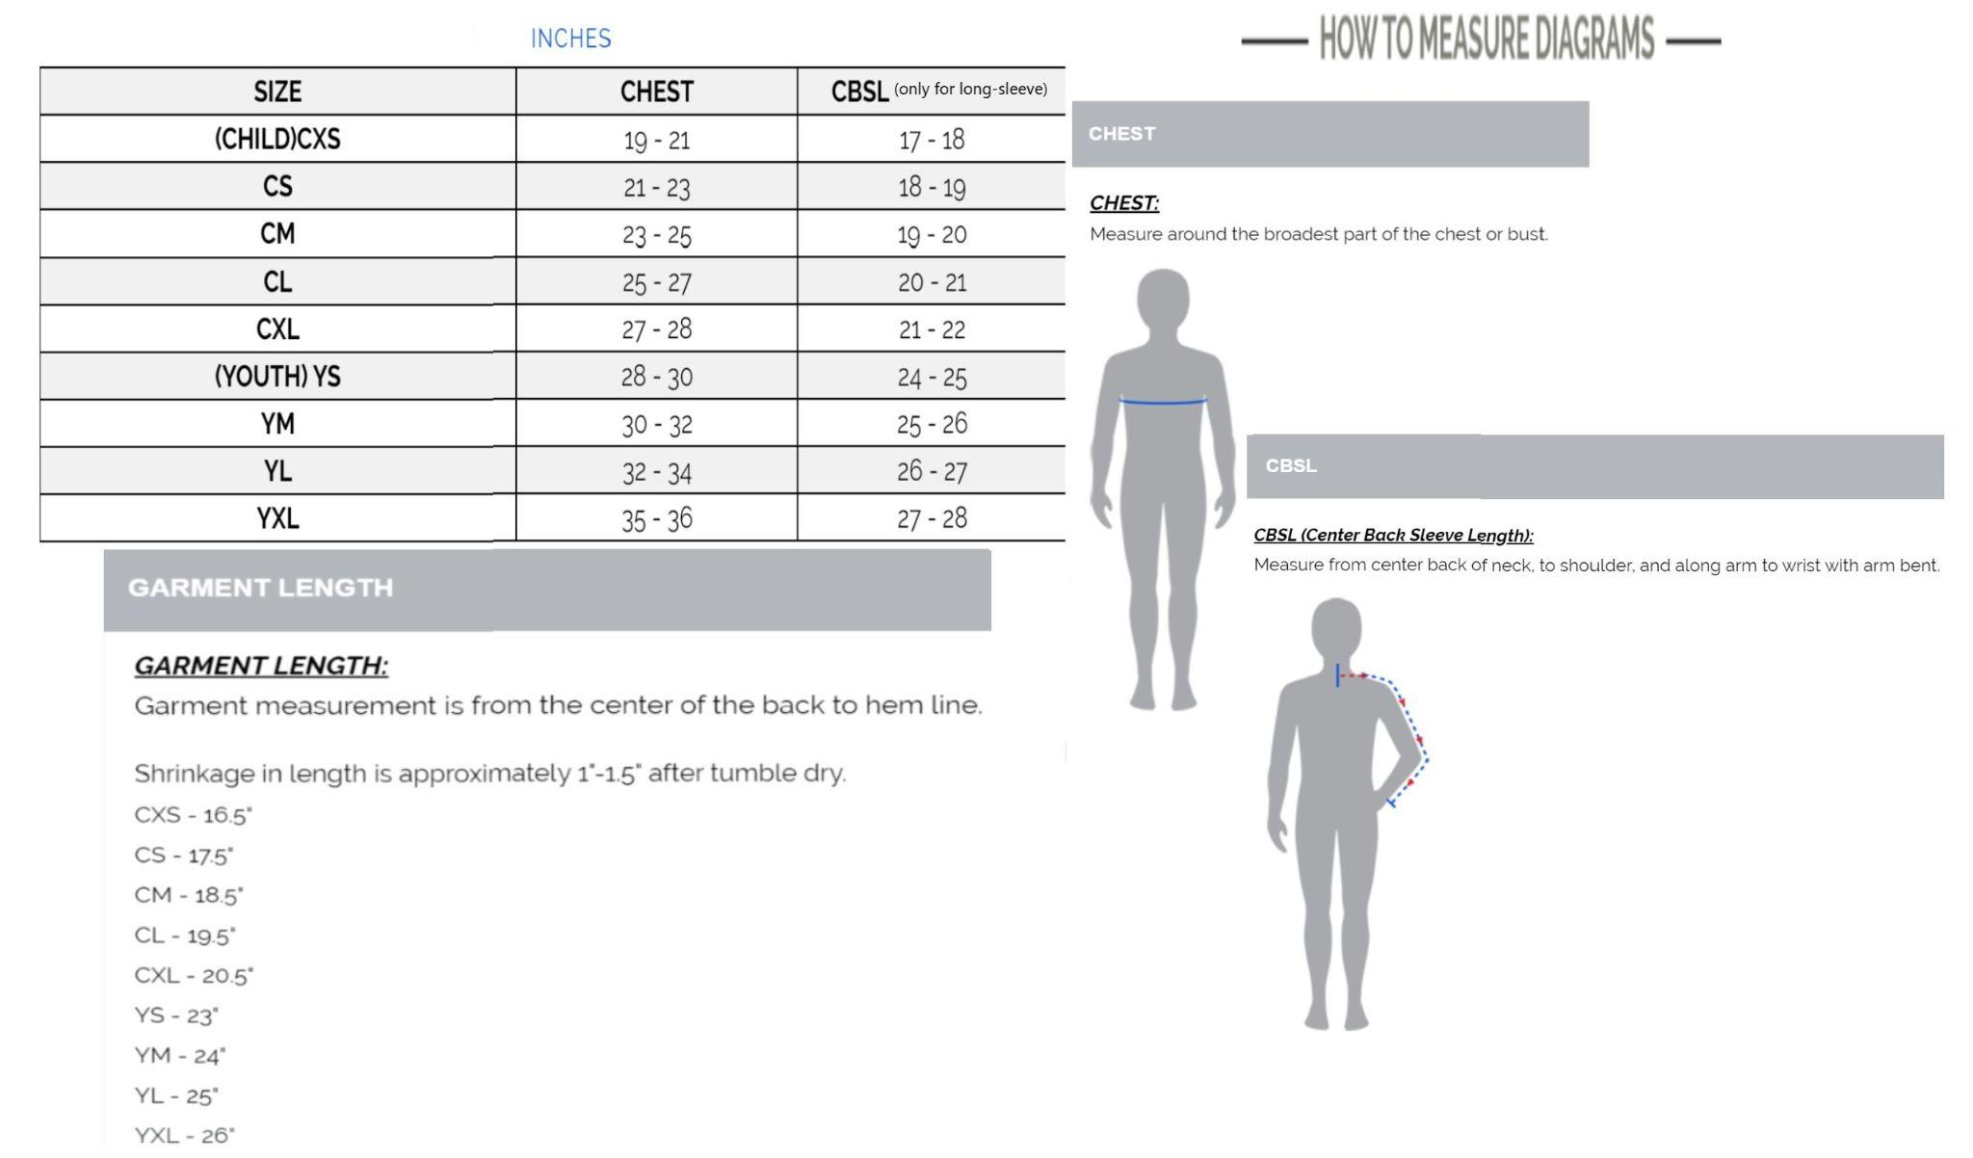
UNISEX GOLF SHIRT - LONG AND SHORT SLEEVE

Slide 9
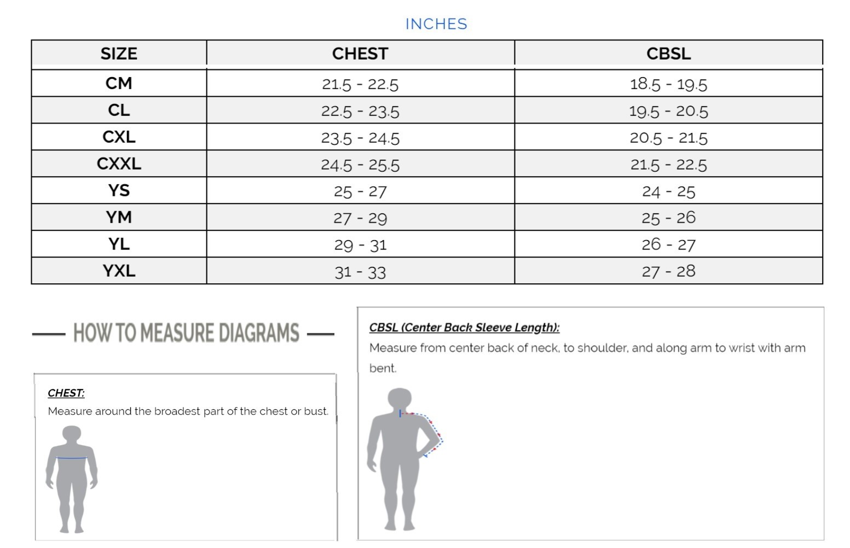
ZIP HOODIE AND CREWNECK SWEATSHIRT

